Slide 1
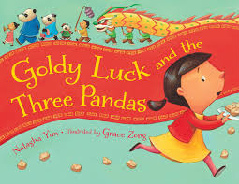
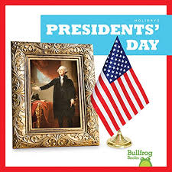
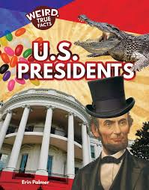
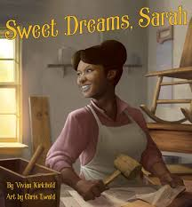
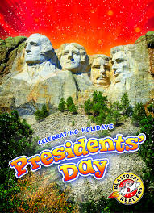
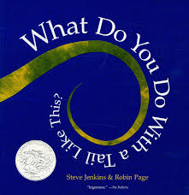
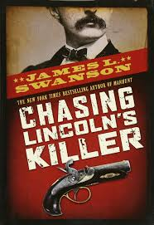
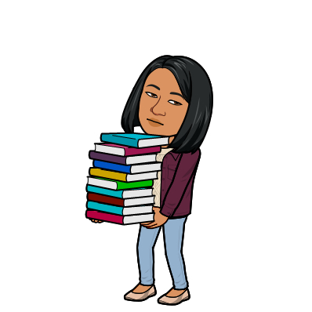
J. CASTAÑEDA LIBRARY
3201 Lima Street, Brownsville TX
← Click to go to our library website
This February we read Valentine books, learned how Chinese New Year is celebrated, talked and discussed history behind Presidents’ Day, learned fun facts about presidents, read and discussed about African-American trailblazers.
Books We Read in February
Reading Objectives Covered for this Month:
*Fact vs. Opinion
*Theme of a Story
*Folktale as a Literary Genre
*Biography as a Genre
Our little crusaders enjoyed learning about animal body parts and their functions. They also learned to distinguish between fiction and non-fiction book.
Upcoming Events:
*Daily hybrid classes
* Read Across America
* St. Patrick’s
* Music in Our Schools
*Women’s History Month
*Continue preparing for
renovation
Our 4th and 5th graders enjoyed the booktalk on this best written YA book about the assassination of Abraham Lincoln.
Ms. M. Colglazier
Librarian
Phone No. 956 698 0661
mircolglazier@bisd.us

