Slide 1
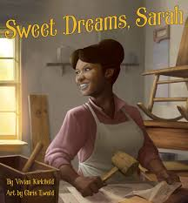
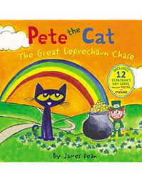
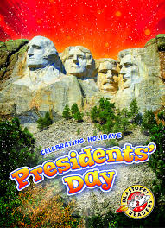
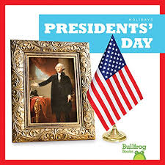
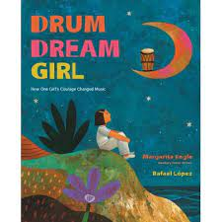
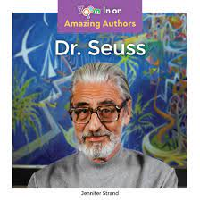
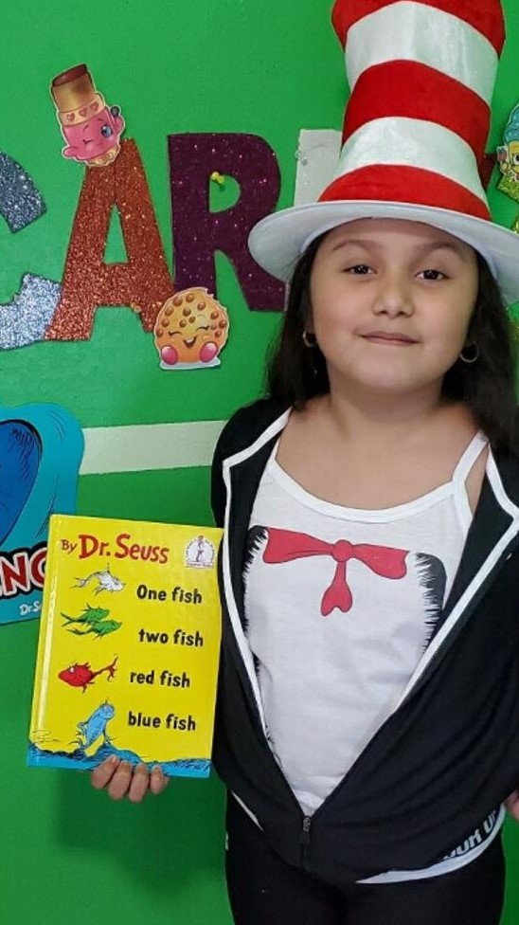
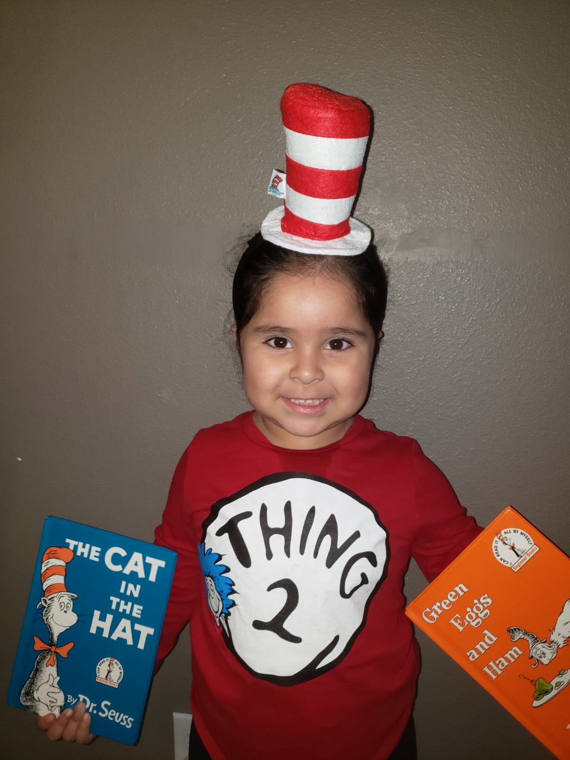
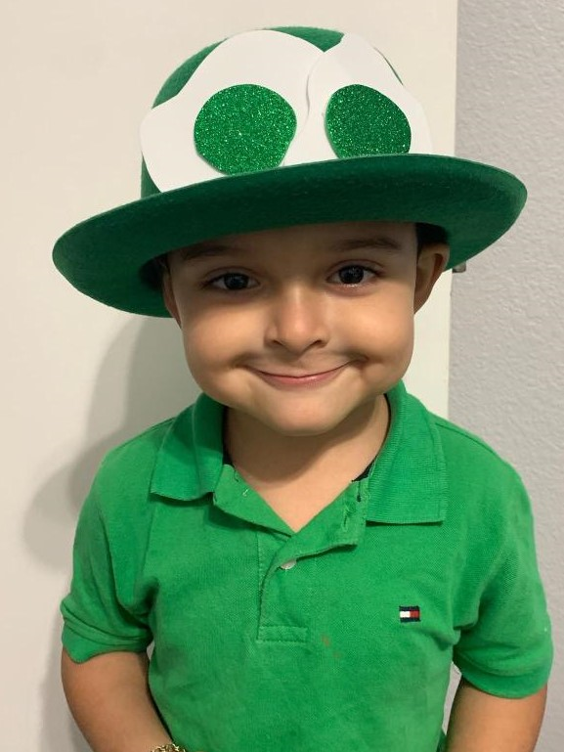
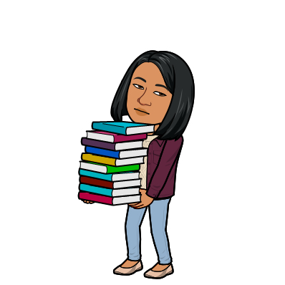
J. CASTAÑEDA LIBRARY
3201 Lima Street, Brownsville TX
← Click to go to our library website
In February we read Valentine books, learned how Chinese New Year is celebrated, talked and discussed history behind Presidents’ Day, learned fun facts about presidents, read and discussed about African-American trailblazers.
Books Read in February & March
Reading Objectives Covered for this Month:
*Fact vs. Opinion
*Theme of a Story
*Folktale as a Literary Genre
*Biography as a Genre
In March, we read leprechaun stories, discussed themes of some Dr. Seuss books, and talked aboutthe importance of persistence and following one’s dream.
Our library renovation finally started during Spring Break!
Upcoming Events:
*Daily hybrid classes
* Poetry Month
* Earth Day
* Dia de los Nińos/Libros
*Our library renovation continues
Read Across America 2021
Ms. M. Colglazier
Librarian
Phone No. 956 698 0661
mircolglazier@bisd.us

