Slide 1
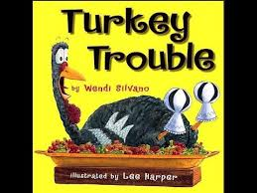
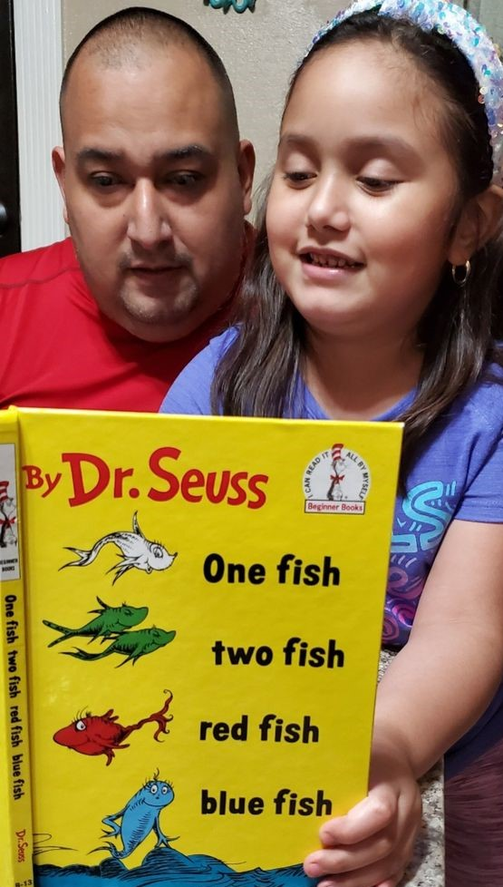
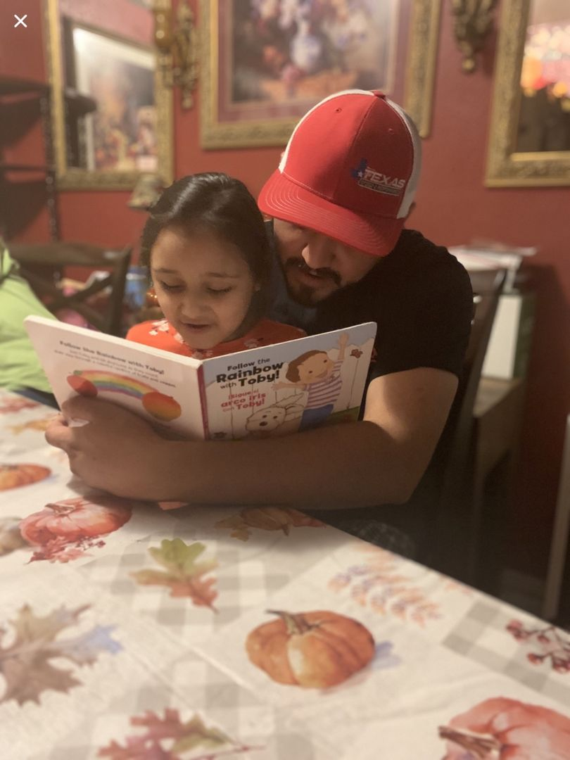
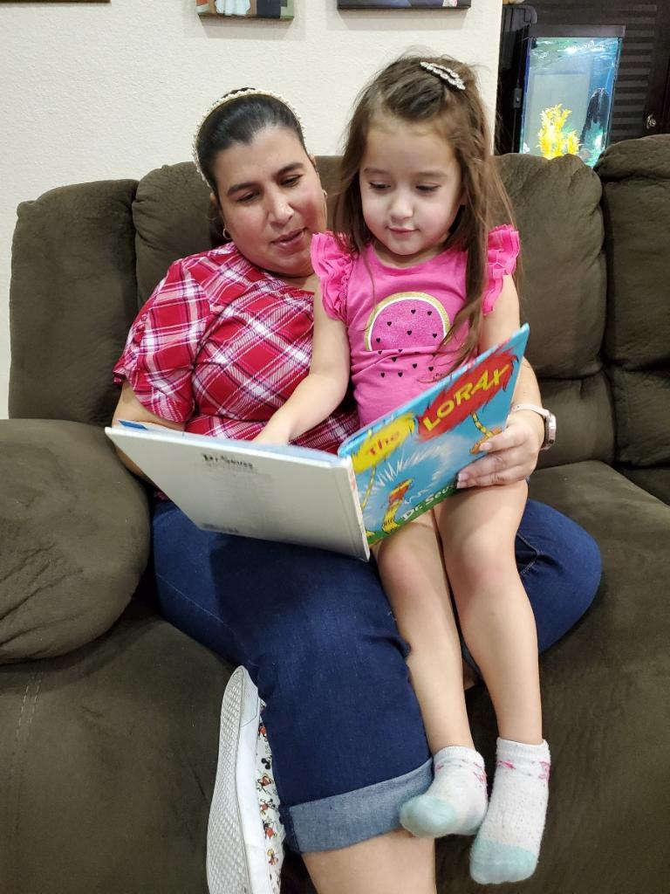
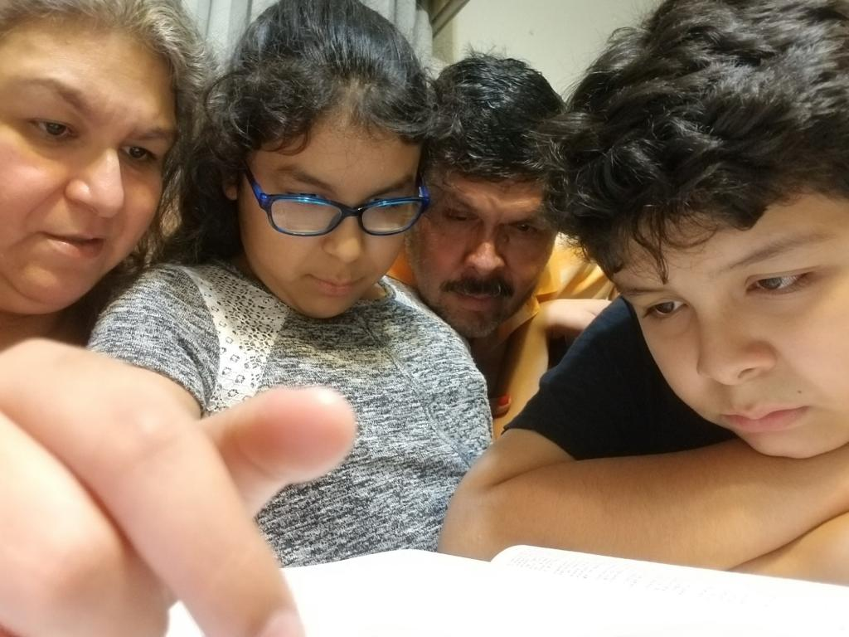
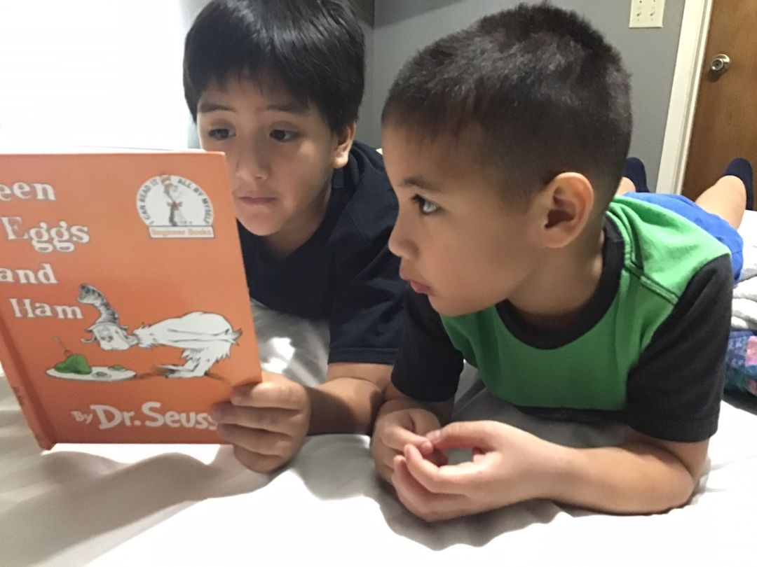
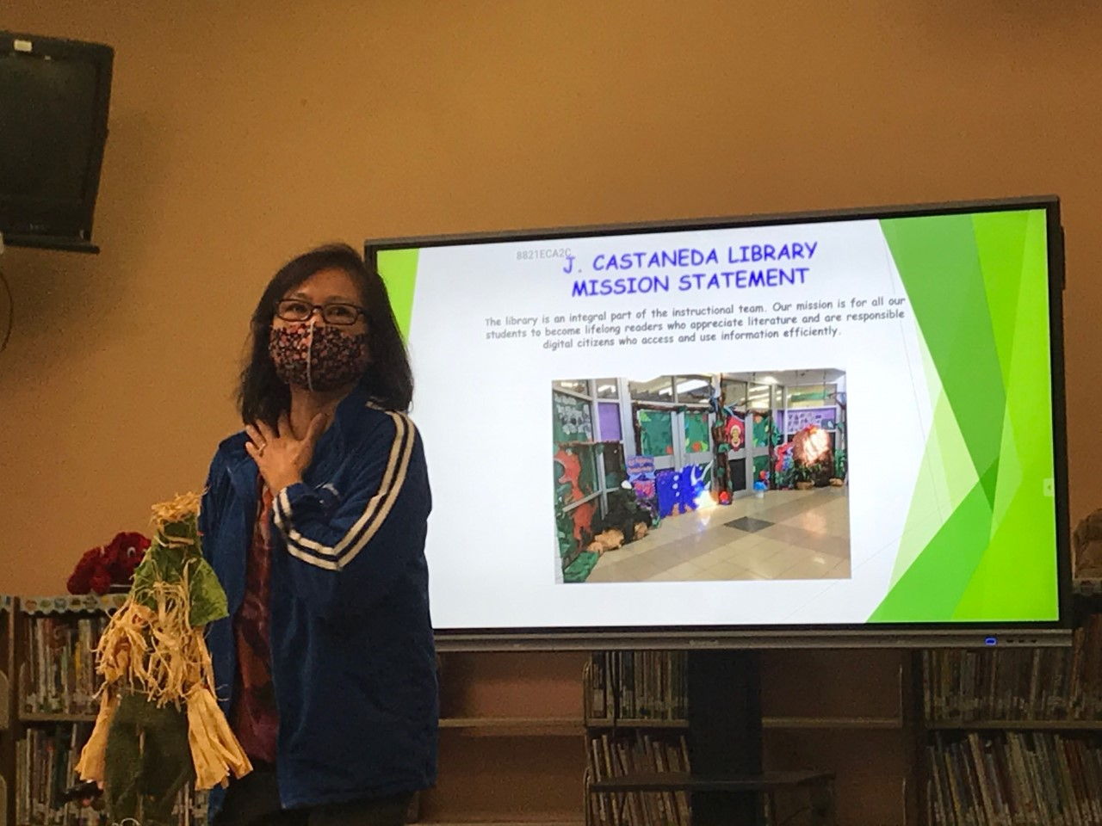
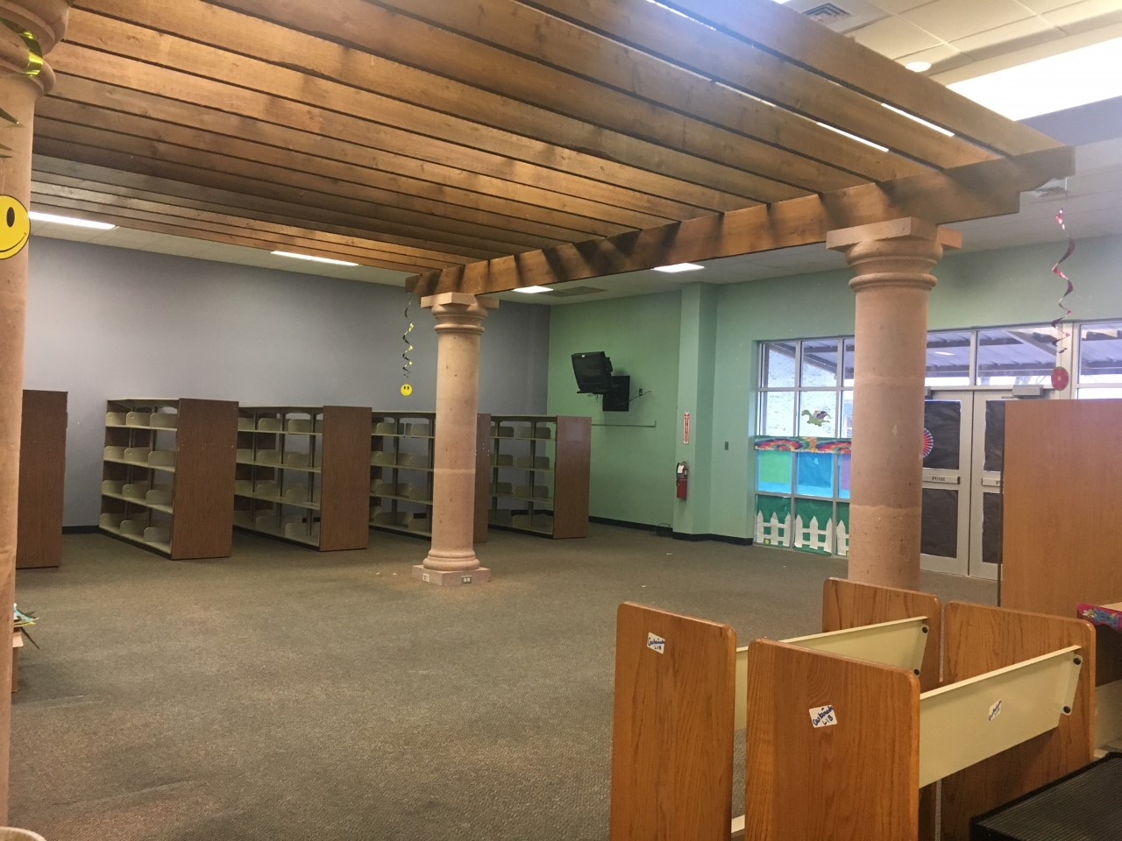
Ms. M. Colglazier
Librarian
Phone No. 956 698 0661
mircolglazier@bisd.us
J. Castañeda Library Website
https://castanedalibrary.weebly.com
November is Family Literacy Month
November Virtual Read Alouds
Featured Bluebonnet book for this month :
Our 4th and 5th graders had a better understanding the journey of immigrant families just like the pilgrims who sailed in the Mayflower ship many years ago with this book:
Preparing for renovation
Upcoming Events:
*Daily hybrid library classes
* Continue preparing for renovation
* Holiday read alouds
* Booktalk on featured Bluebonnet
title/s

