Slide 1
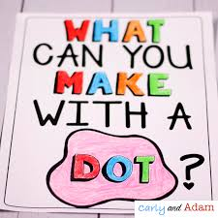
September 2020 Ms. M. Colglazier
Librarian
956 698 0661
mircolglazier@bisd.us
J. CASTAÑEDA LIBRARY
3201 Lima Street, Brownsville TX
In observance of International Literacy Day, we
hosted a free book curbside pick up for our 3rd, 4th
and 5th grade students on September 10 and 11, 2020 from 2:30-3:30 pm. A huge thank you to The Molina Foundation for making this possible. Please click image on the left to see slideshow.
We read the book “Lalo Wants A Real Name” to
celebrate and honor grandparents. Please click image
on the left to see Grandparents Day slideshow.
← Click to go to our library website
Our students love using EPIC and MackinVia
Ongoing Activities:
Accelerated Reader Program
Daily Google meet classes
Preparing for LIBRO Grant renovation
Freedom/Constitution
Week
Sept. 14-18, 2020
Facts about US flag lesson for -PK-2nd
Constitution lesson for 3rd-5th
← See students’ dots
artwork
Upcoming Events:
Hispanic Heritage
LIBRO Grant walkthrough - October 27
Introduce Britannica On Line and BrainPop
Biography as a literary genre
Texas Bluebonnet Reading Program

