Slide 1
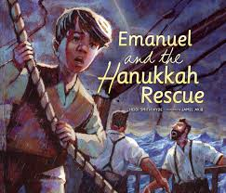
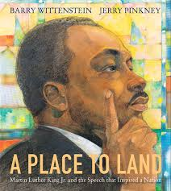
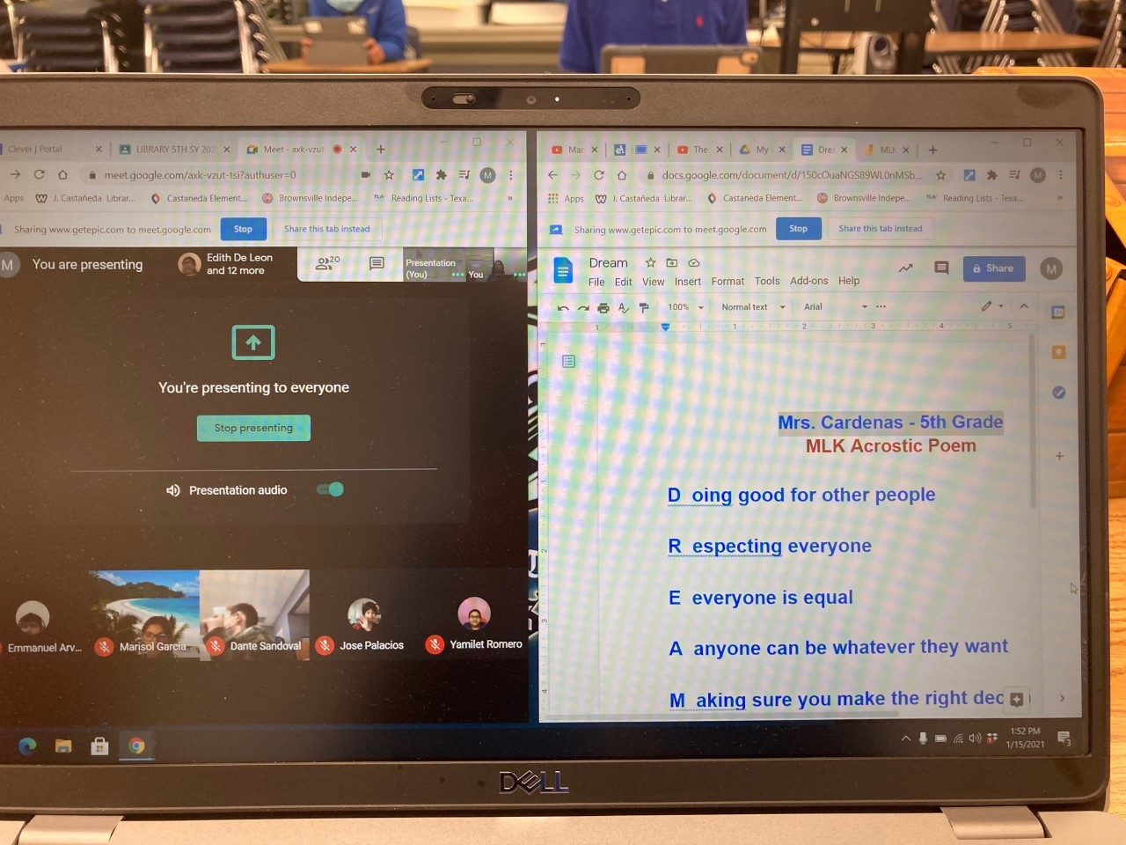
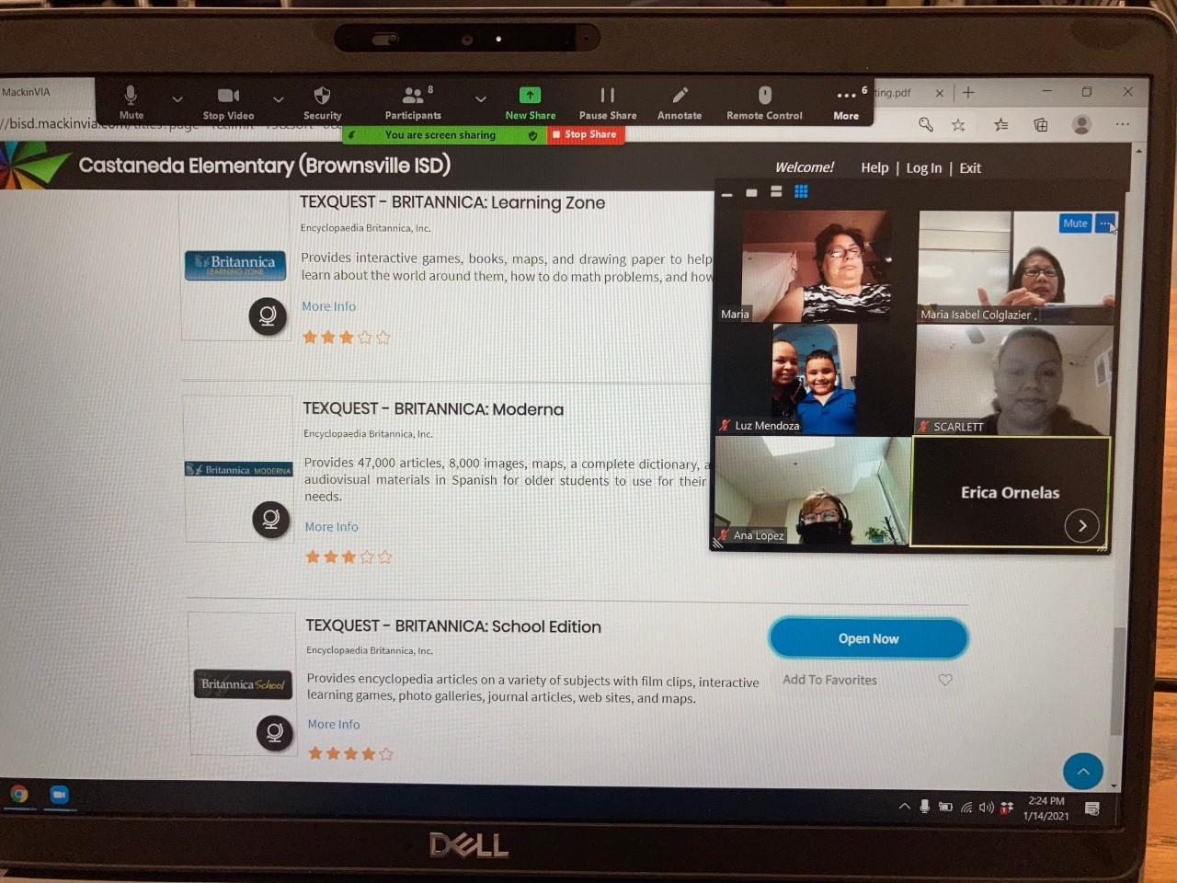
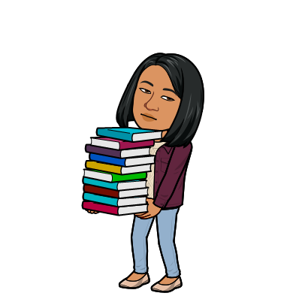
J. Castañeda Elementary Library
Books We Read
Featured Bluebonnet Books:
December / January Activities
* Daily hybrid classes
* Library lessons on Hanukkah,
Christmas family traditions,
hibernation, penguins, Martin Luther
King, Inauguration Day,
* Read winter stories
*Fiction / Non-Fiction (Animals of
Australia)
* LIBRO Planning Meetings 12/15/20;
1/12/2021; 1-26-21
* Zoom Parent Meeting on EBooks 1-14-21
*AR Participation Recognition
*Helped Canales, Stillman and Martin librarians
December
Our 4th and 5th graders learned the extraordinary career of Texas Congresswoman Barbara Jordan.
January
“A Place to Land” is an exemplary book that tells the story behind MLK’s famous speech “I Have A Dream”.
February Upcoming Events:
*Daily hybrid classes
*Black History Month
* Presidents’ Day
* Chinese New Year
*Continue getting ready for renovation
MLK Acrostic Poem Created by
Mrs. Cardenas’ 5th Grade class
Zoom Parent Meeting on E-Books
1-14-2021
Ms. M. Colglazier
Librarian
mircolglazier@bisd.us
956/698 0661
Castañeda Library Website
https://castanedalibrary.weebly.com/

