Slide 1
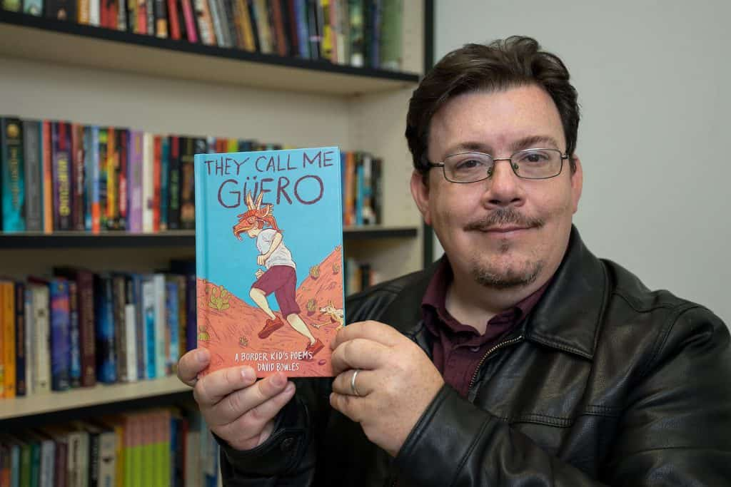
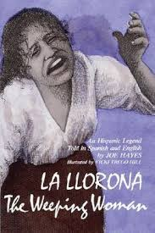
October 2020
Ms. M. Colglazier
Librarian
Phone No. 956 698 0661
mircolglazier@bisd.us
In observance of Hispanic Heritage Month, we read the biography of Ellen Ochoa, the first Hispanic woman to go to space.
J. Castañeda Library Website
https://castanedalibrary.weebly.com
Book talk on these 2020-2021 Texas Bluebonnet titles: Rocket to the Moon and They Call Me Guero.
We also read books written by award-winning
Hispanic authors/illustrators Yuyi Morales and David Bowles.
Our little crusaders enjoyed learning facts, including vocabulary words, pertaining to bats.
We had our LIBRO Grant Walk Through on October 27, 2020. We are excited that our library’s renovation is happening very soon!
Digital Resources on MackinVia
3rd, 4th and 5th grade students learned how to access the different databases (BrainPoP, Britannica On Line, etc.) with a one time log in through MackinVia. They liked the newest addition, Comics Plus, a collection of age appropriate digital comics, graphic novels, and manga.
Upcoming Events:
* Family Literacy Month
* Voting Read Alouds
* Thanksgiving
* AR Recognition - 2nd six weeks
* Prepare for renovation
Virtual Read Alouds for Halloween

